Slide 1

ADCP Toolbox
Tips and tricks
Notes:
Here, I’m going to show you some useful tips and tricks that I’ve discovered while using the toolbox. Some of these you may already know, and some you may not. There is probably more than one way to perform some of these operations, and if you know of a more efficient way, please let me know so that we can all benefit.

Slide 2
Using WINADCP shortcuts
Preliminary data checks
Determine first and last good ensembles
Manually use rdi2cdf.m

Slide 3
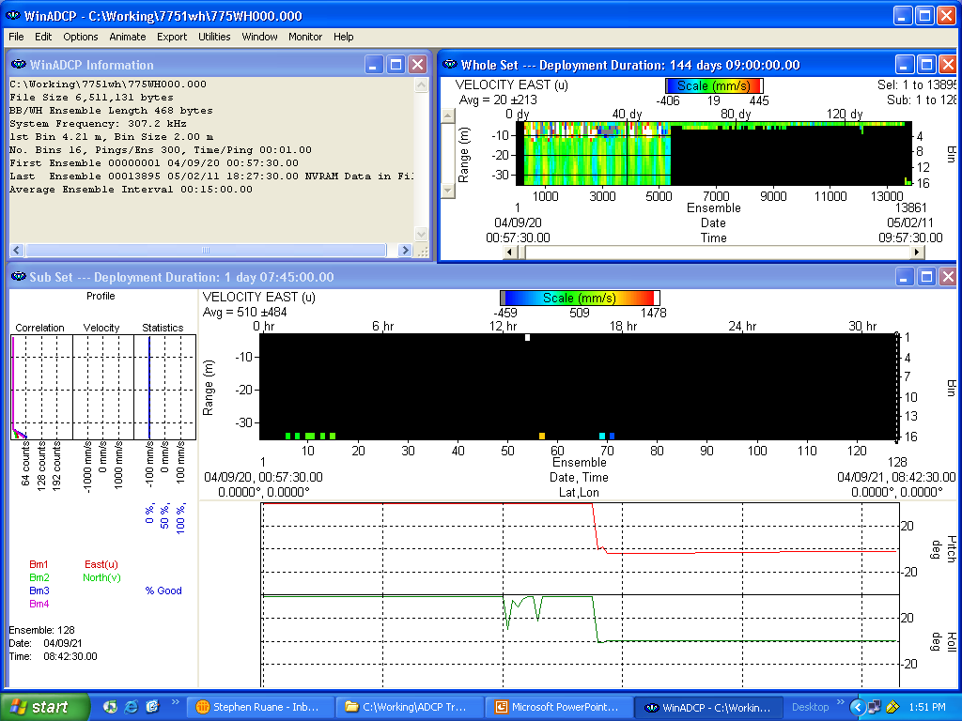
Open data file in WINADCP
Notes:
Open the data file 775WH000.000
From the first glance, I know that something is strange with this data file because I know that this is a 4 month deployment and I usually stop the ADCP shortly after recovery, so there shouldn’t be too much bad data at the end of the file.

Slide 4
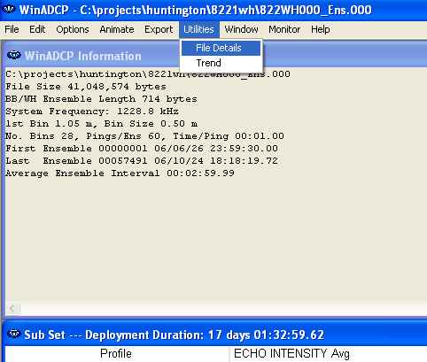
Check File Details
Select Utilities ->
File details
Select your raw, binary data file
(*.000, *.PD0)
Usually, your file is already selected.

Slide 5
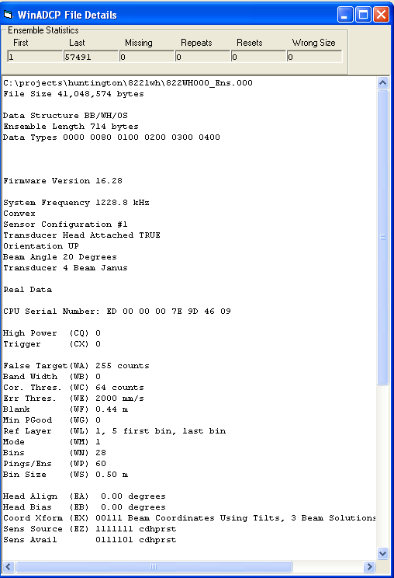
Review the ADCP Settings
Note missing ensembles
Note orientation (UP or DOWN)
Note EB setting (declination)
Write these down!

Slide 6
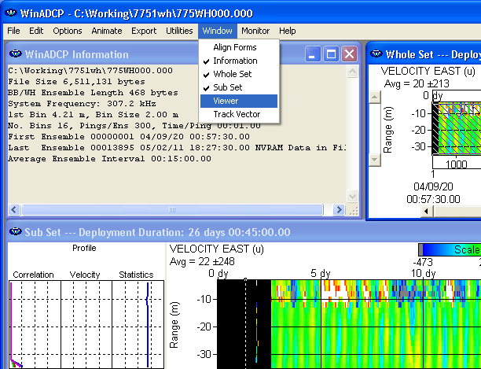
Examine file using File Viewer
Notes:
From the Window menu choose Viewer.

Slide 7
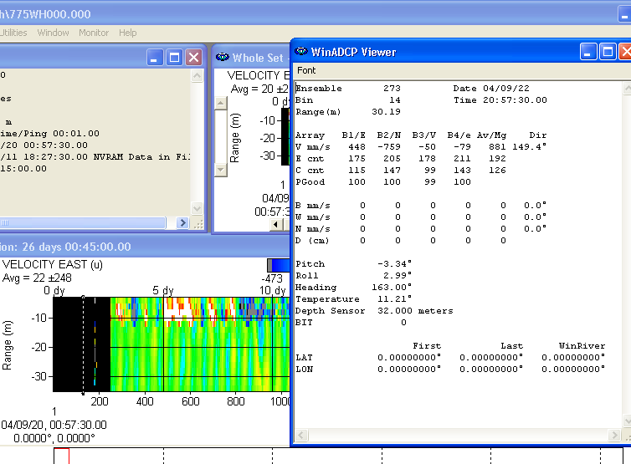
Determine first/last good ensembles
Move mouse along subset and look at pitch, roll, heading
Notes:
Move the Viewer window to a place where you can see the beginning of the data file. Now, slide the mouse over the subset and you’ll see the values change in the Viewer window.
At least for fixed platform deployments, you can determine when the tripod is on the bottom based on when the heading, pitch, and roll all become constant. That will mark your first good ensemble.
For the last good ensemble you can see when either heading, pitch, or roll have changed. Record these numbers on the processing procedure checklist.

Slide 8
rdi2cdf.m description
rdi2cdf(infile, outfile, rec1, rec2)
Last good ensemble
rdi2cdf(‘775wh000.000’,’7751wh000.cdf’,250,5429)
First good ensemble
Notes:
Here, we’ll be using rdi2cdf to trim the beginning and ending ensembles based on the limits that we just found using WinADCP. This will eliminate some extra processing and cut down on the time it takes to run runadcp. It will make your life a lot easier.

Slide 9
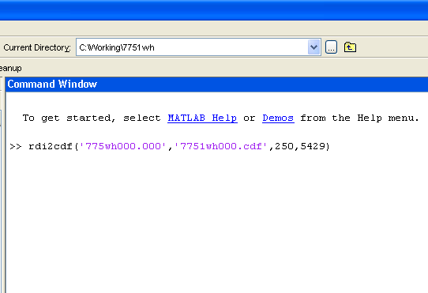
Call rdi2cdf.m

Slide 10
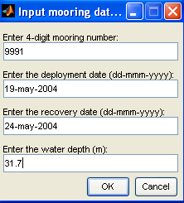
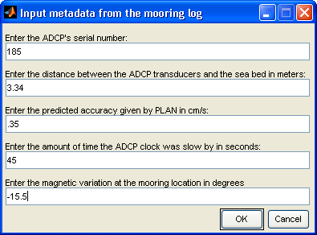
Enter metadata
Same as we did before using runadcp.m
Notes:
This will convert the raw binary data to netCDF format.

Slide 11
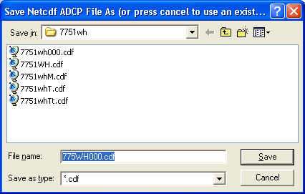
Now start runadcp.m
But….when prompted for saving the netCDF file…click Cancel

Slide 12
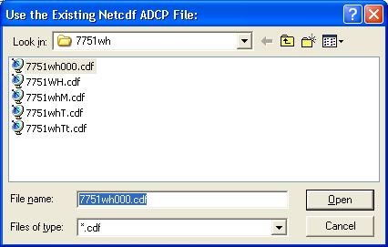
Choose the netCDF file you already created
Click Open and continue with the toolbox as before
Notes:
You will notice in the StarBeam browser that the file has already been trimmed to the appropriate ensembles.

Slide 13
Debugging clock errors
ADCP clock is off by a lot(~1hr)
Is it really a clock error?
Perhaps the ADCP had a hiccup
Use WINADCP to find out
Use checktime for a report on the clock

Slide 14
Open file in WinADCP
View ClockError.000

Slide 15
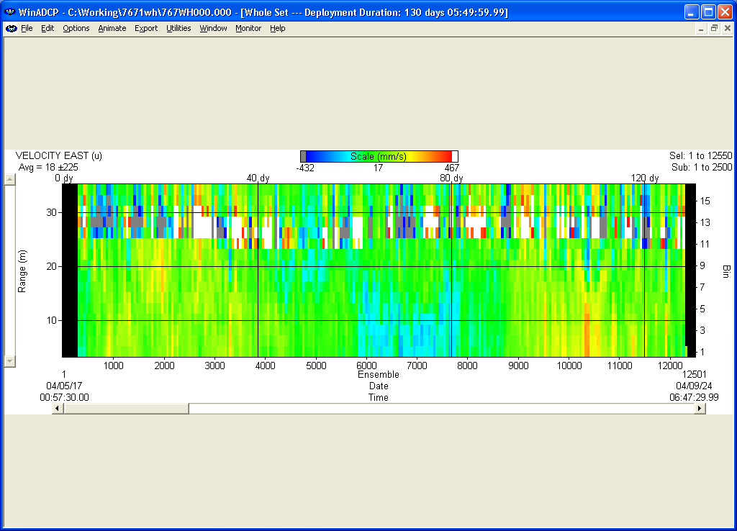
Recognize the problem
Start at 00:57:30.00
End at 06:47:29.99
15 min interval
It just doesn’t make sense!!!
Notes:
In this data file, the time of last ensemble doesn’t agree with the 15 minute interval that was supposed to be maintained by the ADCP.

Slide 16
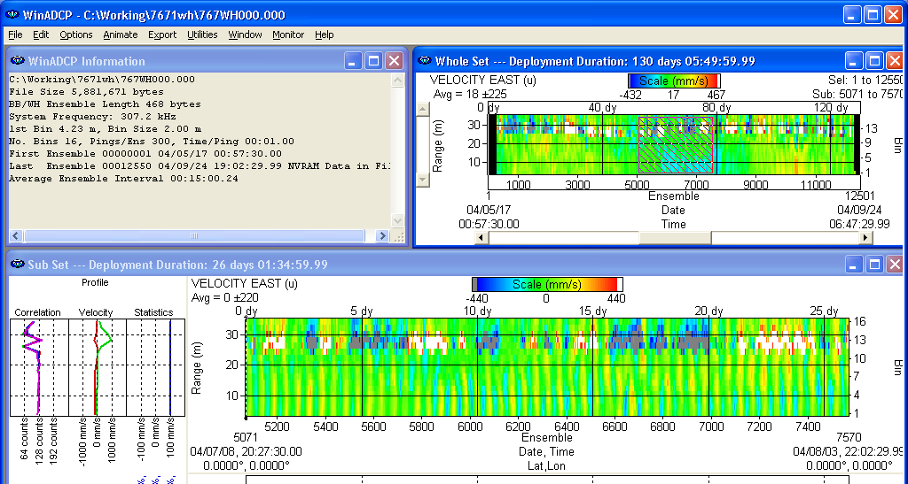
Find valid subset of data
Advance the scroll bar until the subset beginning and end times don’t follow the ensemble interval
Notes:
This will allow you to use File Viewer to pinpoint exactly where the time stamp changes.

Slide 17
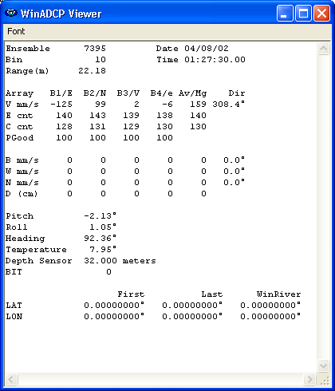

File Viewer
Drag the mouse pointer across the subset until the time stamp interval changes. Notice the gap in the time.
Notes:
In the advancement of just one ensemble, from 7395 to 7396, the time jumped approximately 65 minutes. But the interval is 15 minutes???

Slide 18
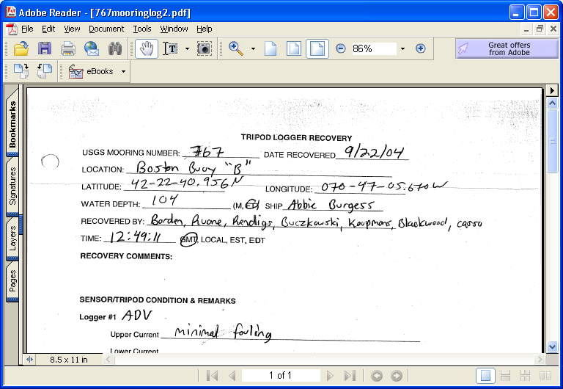
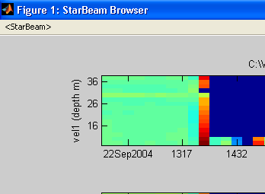
Examine timing marks
Data file shows that ADCP is recovered about 1 hour after the mooring log timing marks
Notes:
A good reason to keep good timing marks. Now we know that the timestamp for ensemble 7396 is incorrect. It is quite possible then, that the ADCP continued to sample at the regular 15 minute interval, and we will have to correct the time stamp for ensembles 7396—end. It is good practice to compare with other instruments, if possible, to be completely certain that it is just a timestamp error.
The math:
Ensemble 7396 timestamp should be 1:42:30, but is actually 2:32:29.99, so there is a difference of ~50 minutes.
The data file shows that the ADCP recovery began at 13:32:30.
Subtract 50 minutes and the recovery actually began at 12:42:30, which matches closely with the mooring log.
So for each ensemble starting at 7396 the timestamp needs to be adjusted by -50 minutes.

Slide 19
The Math…
Ensemble 7396 timestamp should be 1:42:30, but is actually 2:32:29.99, so there is a difference of ~50 minutes.
The data file shows that the ADCP recovery began at 13:32:30.
Subtract 50 minutes and the recovery actually began at 12:42:30, which matches closely with the mooring log.
So for each ensemble starting at 7396 the timestamp needs to be adjusted by -50 minutes.

Slide 20
Find the TE setting
What was the time between ensembles ?
Look in the *.whp file
Or use WinADCP’s File Details
TE00:15:00.00 = 15 min interval
TEhh:mm:ss.hh = time between ensembles

Slide 21
Run checktime.m
checktime(thedatafile,theTE)
  Thedatafile is a *.cdf or *.nc file
  TE is the ensemble interval in seconds
checktime('7861wh.cdf',15*60)

Slide 22
Checktime output
ADCP time stamp evaluation
There are 0 NaNs in the variable TIM
ADCP start time is 16-May-2005 00:57:30 at ensemble #1
ADCP end time is 28-Sep-2005 17:12:30 at ensemble #13026
ADCP mean time between ensembles is 900.000000 sec
Instrument log indicates ADCP was slow by 51.000000 sec
Checking clock drift by elapsed ADCP clock vs predicted
Elapsed real time = 11723400.000000 sec
Elapsed ADCP time = 11722500.000003 sec
Elapsed real-ADCP time = 899.999997 sec
ADCP end time is 28-Sep-2005 17:12:30 at ensemble #13026
Predicted end time is 28-Sep-2005 17:27:30 for 13026 ensembles
Last ADCP ensemble was early by 899.999997 sec
Instrument log indicates ADCP was slow by 51.000000 sec
Looking for time issues
4342 ensembles or 33.333333% of intervals are greater than 900 sec
8683 ensembles or 66.658990% of intervals are less than 900 sec

Slide 23
Interpreting checktime output
ADCP mean time between ensembles
  Is this reasonably close to the TE setting?
Last ADCP ensemble was early/late
  Does this agree with the clock drift?
  (Instrument log indicates ADCP was slow/fast)
Ensembles > or < TE interval
  Is this tolerable?
  4342 ensembles or 33.3% of intervals are greater than 900 sec
  8683 ensembles or 66.6% of intervals are less than 900 sec
Check the histogram

Slide 24
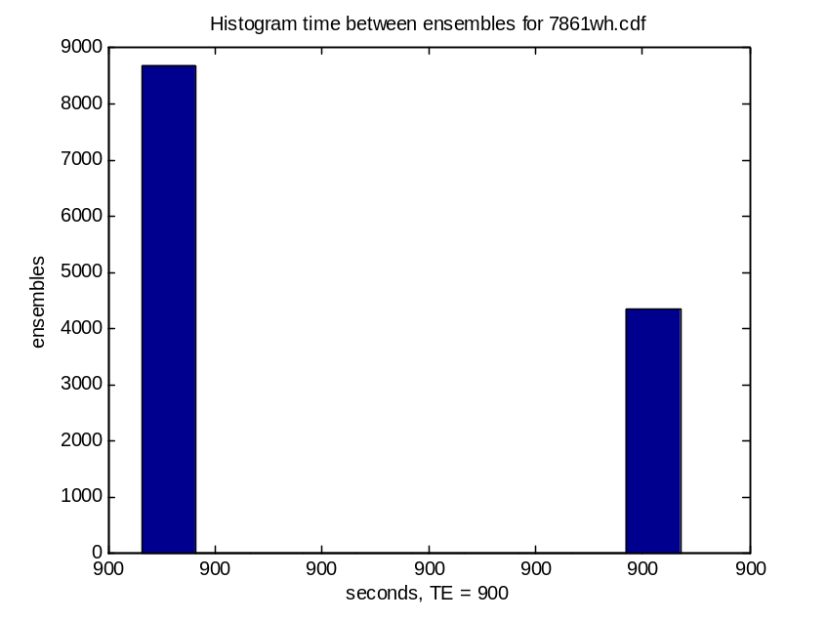
Checktime histogram
If all the x-axis tick labels match TE, the variation in time is not significant
If not, the bars show how many ensemble intervals vary by how much.
Notes:
The histogram distributes the ensemble intervals into 10 groups.
The x-axis tick labels will all be the same if the 10 groups vary by less than 1 second.

Slide 25
When important attributes are not specific
EXPERIMENT = ‘OTHER’
PROJECT = ‘OTHER’
DESCRIPTION = ‘OTHER’
Notes:
The ADCP Toolbox contains certain default attributes in the dropdown menus when entering important metadata. Many times, the experiment, project, and site description that pertain to your experiment are not listed. In this case, as was shown before, the correct choice would be to choose ‘Other’.
That’s not a very descriptive name for an attribute to an archived EPIC netCDF file!
Here is one way to adjust those attributes to your needs:

Slide 26
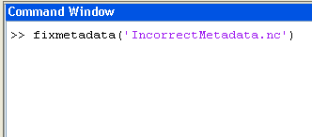
Use fixmetadata.m
Type the above statement at the MATLAB prompt.

Slide 27
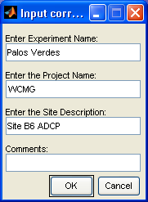
Enter correct information
Notes:
The default values will be the ones that are already contained in the data file. The changes will occur after you click OK. You can check this by using ncbrowser or ncdump.

Slide 28
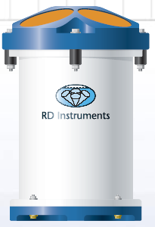
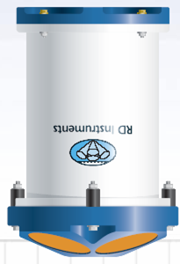
Orientation correction
Why does netCDF file have the incorrect orientation?
Source: www.rdinstruments.com
Notes:
Many times, the ADCP is programmed to start a few days before the actual deployment because it is assuring to hear the instrument ping, or collected data prior to deployment. Then, at least we know that the ADCP was working at deployment.
The orientation information obtained in the netCDF file is based on the first ensemble in the data set. If the deployed orientation of the ADCP is upward looking, and at the time of first ping, the orientation of the ADCP is down-looking, this error will occur.
To correct this error, you can use fixorientation.m.

Slide 29
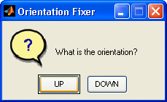
Using fixorientation.m
Notes:
In the extraMs directory within the ADCP toolbox there is a script to fix the orientation of the ADCP. It is called with the filename as the input. Usually, I like to adjust this in the first raw netCDF file because then all subsequent files will maintain the correct orientation. The default orientation is ‘UP’.

Slide 30
Examples of bad data
Open BadData1.cdf in StarBeam Browser

Slide 31
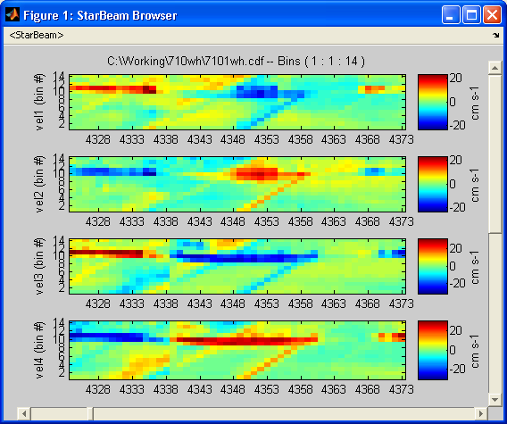
More Bad Data
Notes:
Here, we see some striping effects in the data that just don’t look right. The errors in this interesting data set were believe to be caused by a malfunction in the internal processing of the ADCP.
You would want to mask out these 'stripes' of data

Slide 32
Open another file…
Open BadData2.cdf in StarBeam

Slide 33
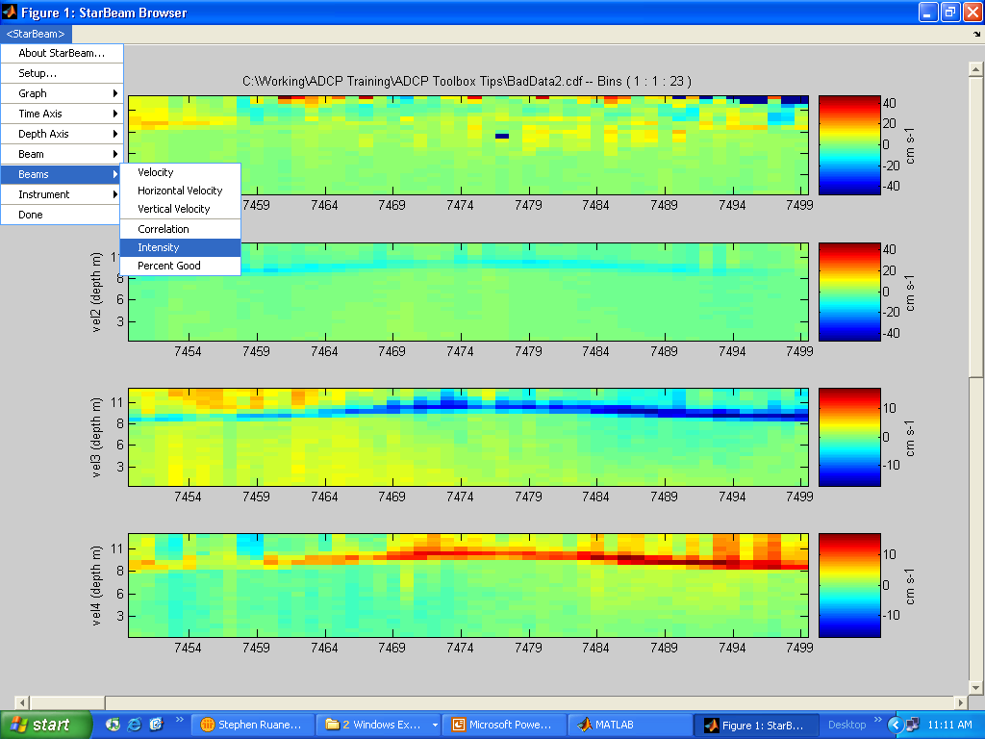
Change view to Intensity
Notes:
Here you’ll notice that the velocity profile in beam 1 looks a little different than the rest….

Slide 34
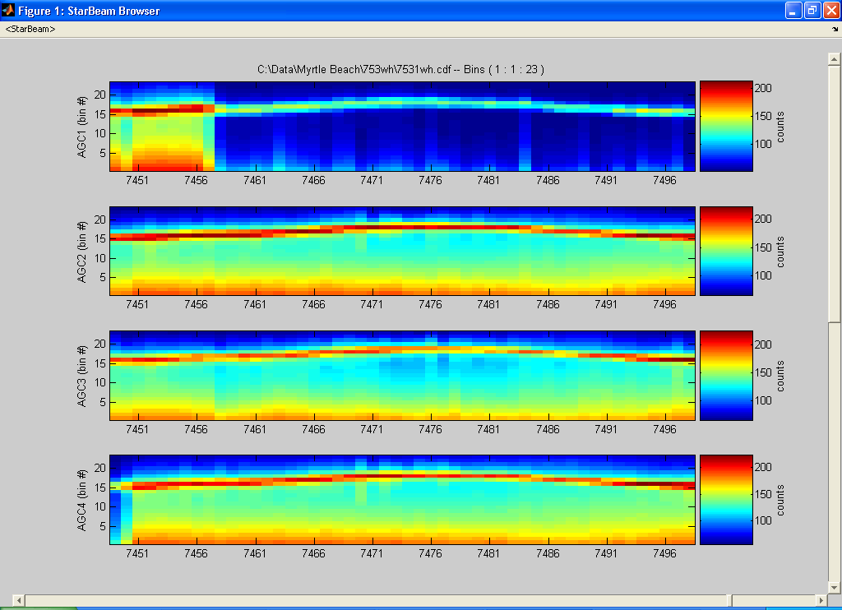
Something on the transducer?
Notes:
We are now looking at the intensity profile of this data set. Notice how in beam one, the surface is still visible, but the rest of the water profile doesn’t look right.

Slide 35
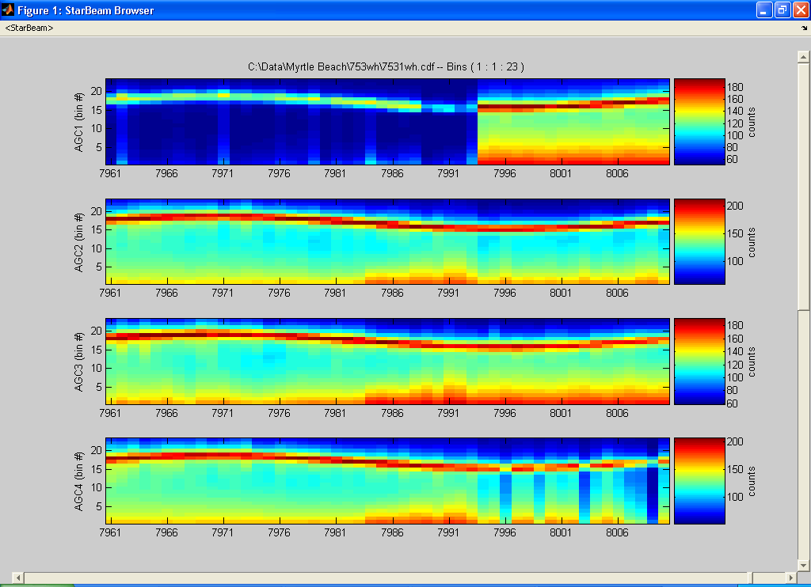
Where did it go?
Notes:
Just as quickly as the problem began in beam one, it leaves. Perhaps something was sitting on the transducer! Our recommendation here would be to mask out all of beam one for those ensembles, which will force a 3-beam solution and should be OK.

Slide 36
Another example…
Open BadData3.cdf in StarBeam

Slide 37
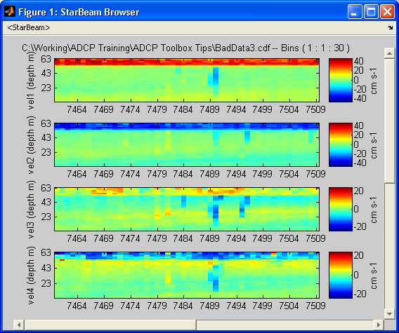
More bad data
Notes:
In this data set, BadData3.cdf, here are the masking suggestions:
Check out the intensity profile too!
7490 all bins, all beams
7488 mid depth, beam 3
7495 mid depth, beams 2,3
7489 mid depth, beams 1,2,4

Slide 38
One more…
Open BadData4.cdf in StarBeam

Slide 39
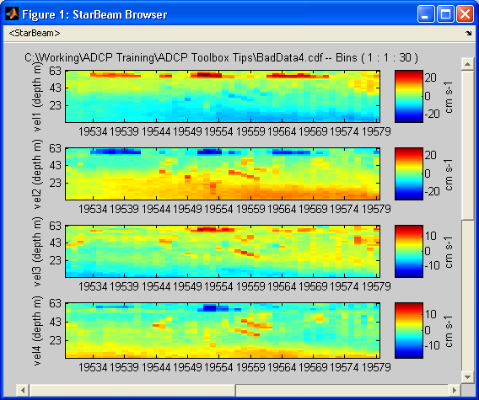
Last one
Notes:
In this example, BadData4.cdf we recommend masking all beams above the stripe for ensembles 19555-19560.
This was a one time occurrence in this data set, so it is considered unreliable. However, if something like this were to occur more systematically, then it would require a closer examination as to whether or not it is valid data.

Slide 40
Using Batch Processing
Run the toolbox with minimal user interaction
Not good if it is a data set with a lot of errors
StarBare and RD Surface inputs remain
Use command batch(‘demo.bch’)
Notes:
Where demo.bch is the name of the batch file that you created.

Slide 41
Questions???

